Slide 2
Information Protection in 2013:
Hybrid RMS, Generic Protection, and iOS/Android/WinRT Support
WCA-B322
Dan Plastina

Slide 3

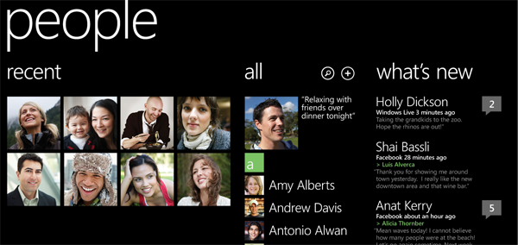
Industry trends
Consumerization of IT
Users need access, from any device
Externalization of IT
Applications are on-premises and in the cloud
More Data, Stored in More Places
Dispersed enterprise data needs protection
Social Enterprise
Data is shared between people and applications
The traditional perimeter is rapidly eroding
IT needs continuous data protection that work across ‘classic ‘boundaries’

Slide 4
Information Protection Market Realities
In-market IP offers are lacking key capabilities
  Despite Microsoft’s leadership position, we too have several challenges.
  The industry is well over due to solve this problem. It’s a hard one.
IT knows users do collaborate
  Information workers don’t seek to be malicious; it’s about personal productivity.
  Limited tooling prevents IT from knowing just how much data ‘leaks’.
COIT / BYOD is raising risk at an unprecedented rate
  BYOD introduces ‘shared security contexts’ mixing personal / work personas
  Simple mistakes are simpler than ever to make: Cloud-drives sharing My Documents
  Nuanced behaviors escape many users: Cloud-drive share-in-place is long lived!

Slide 5
Dan’s Laws of Information Protection
Data exists to be consumed
Data will flow across data stores, devices, and orgs; it will flow from on-premise to the cloud and back. If data does is not let to flow, it is not being sufficiently used!
Protection = Encryption + Policy
Encryption alone is uninteresting and quite plentiful already.
Policy, when associated with data, offers an extended reach not offered by the traditional perimeter.
Protected data is consumed by more than humans
It should be possible for protected data to be reasoned over by ‘authorized compute nodes’.
Protection should exist in two measurable tiers
Encryption is dissolved before anything useful is done. This is inevitable.
PRE AUTHORIZATION protection must offer very robust protection against adversaries.
POST AUTHORIZATION protection is need be as ‘transparent’ as possible in everyday use

Slide 6
Approaches to Protecting Information
Transparent Drive Encryption is good, yet not sufficient
  We’ve always wanted to protect the data, not the container… it’s just been too hard.
  e.g.: A SAP report run by an privileged user
  e.g.: SkyDrive data synced from a BitLocker’ed hard drive.
Data Centralization is a start, but not the end point
  Like it or not, data will move around. Central repositories are very convenient but one must accept that data will live on devices and ‘cloud drives’. Protect (not just encrypt) data before it moves.
Network layer protection as a stop-gap offer
  Content Encryption Gateways are interesting as a stop-gap but have two core weaknesses: 1) They require unnatural network topologies and 2) They degrade in functionality when associated services are required to ‘reason over data’.

Slide 7
We are promising:
I can protect any file type
I can consume protected files on important devices
I can share with anyone and they can sign up for free
I can share with any business user
I can share with any individual (LiveID/GMAIL ID)
I can keep my data on-premise (if the cloud scares me)
I can control my RMS ‘tenant key’ from on-premise
I am aware of what is going on with my protected data
I can rely on MSFT + Partners for complete solutions

Slide 8
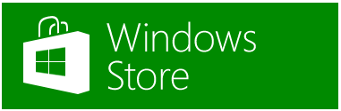
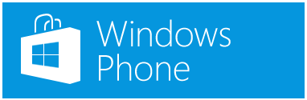




On All Important Devices
SDKs ‘everywhere’ support enlightened applications
  WinClassic, iOS, Android, WinRT, WinPhone, Mac and REST services
  Enlightened applications such as Office, Foxit PDF reader, and our own viewer use these same SDKs.
  It is critically important to note that these SDKs only work with Azure AD RMS

Slide 9
Protection of any file type, on all Devices
Text and images get special treatment → name.Pxxx
  TXT becomes PTXT, XML becomes PXML.
  JPG becomes PJPG, PNG becomes PPNG… same for JPEG, TIFF, BMP, GIF
Others ‘wrapped’ with protection → name.ext.PFILE
  File are ‘wrapped’ with the export right set. We unwrap and launch. Think WinZip™ with RMS.
  This approach maximizes compatibly given existing application can open the file.
  When the system uses Pxxx or PFILE or protect natively is configurable by the ITPro. e.g.: TXT.PFILE
We offer a free viewer on all 6 platforms!
  It will enforce viewing of all the Pxxx files and launch all xxx.PFILEs after authentication
  It may offer viewing of email messages (Outlook’s rpmsg message format) – in POC stages
  It may offer viewing of Office files on devices that offer in-built Office viewers – in POC stages

Slide 10
Demo:
Protecting any file
Windows IPViewer ‘Right-Click’ capabilities
NOTE: IPViewer is a Beta product. Polish pending!

Slide 11
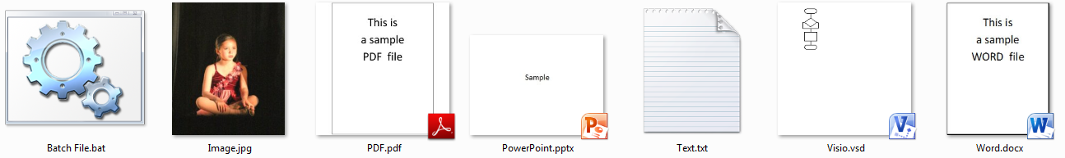
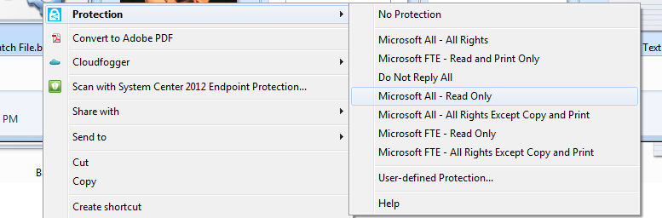
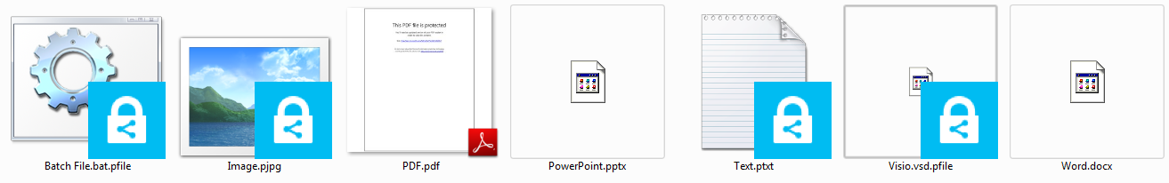

Slide 12

Demo:
Protected PDF files
Today’s demo in partnership with:
Foxit is a leading software company supported by 100+ PDF engineers. They were founded in 2001 and are headquartered in Fremont, CA but have worldwide sales and support operations throughout USA, Europe, Asia, Japan and Australia. They currently have hundreds of millions of active users within their 95,000+ customers, in 150+ countries on 6 continents.

Slide 13
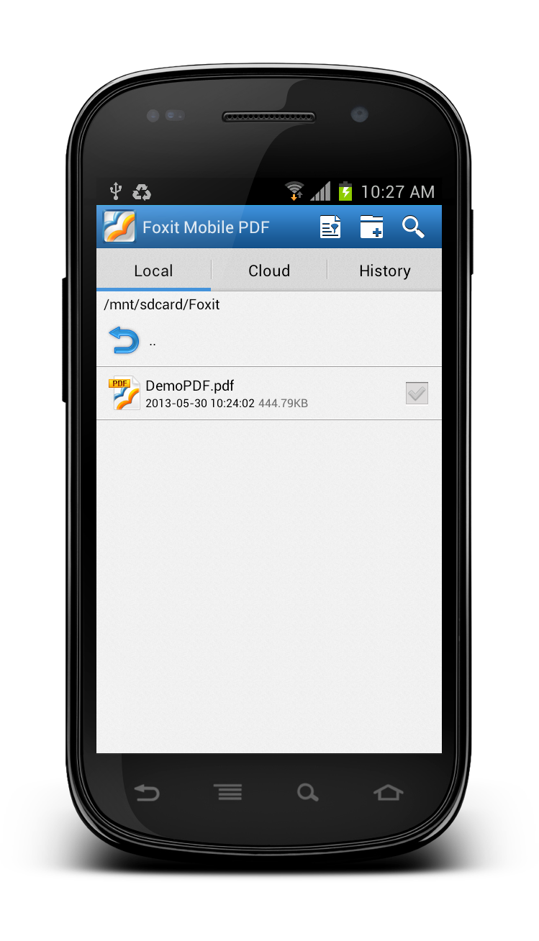
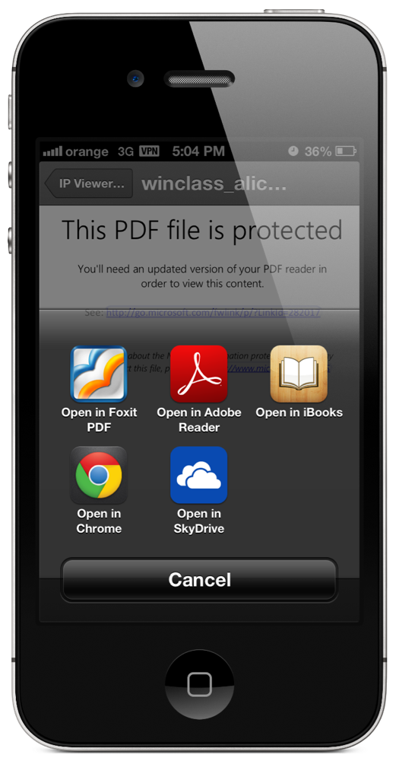
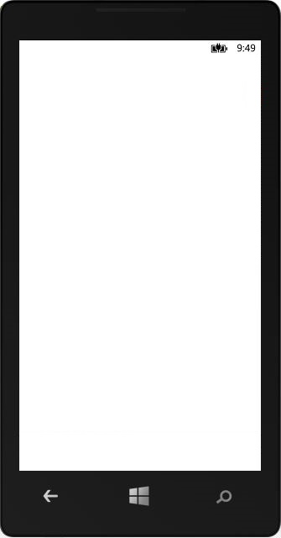
Coming Soon!

Slide 14
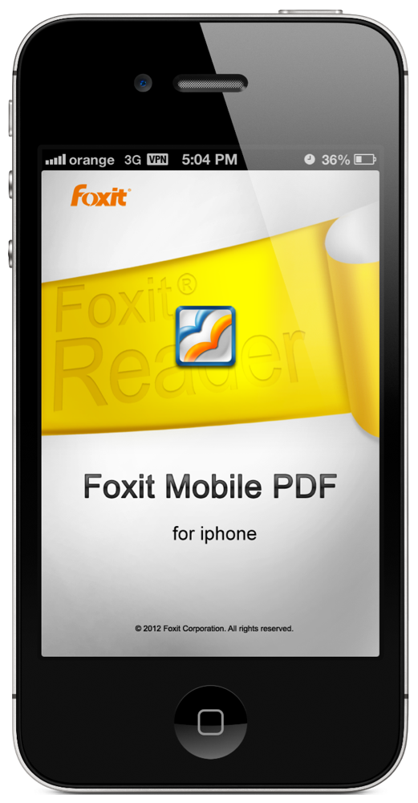
Coming Soon!

Slide 15
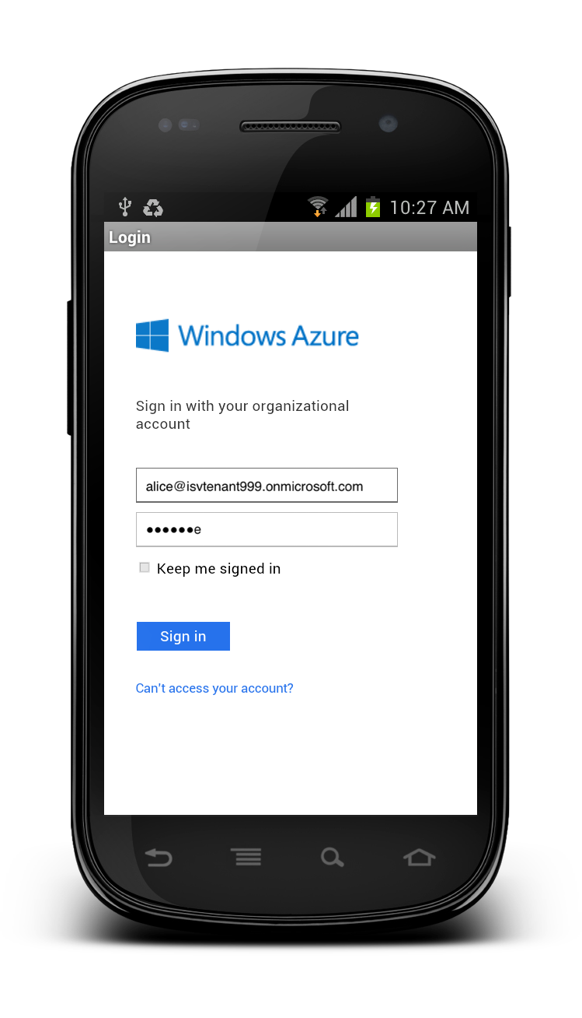
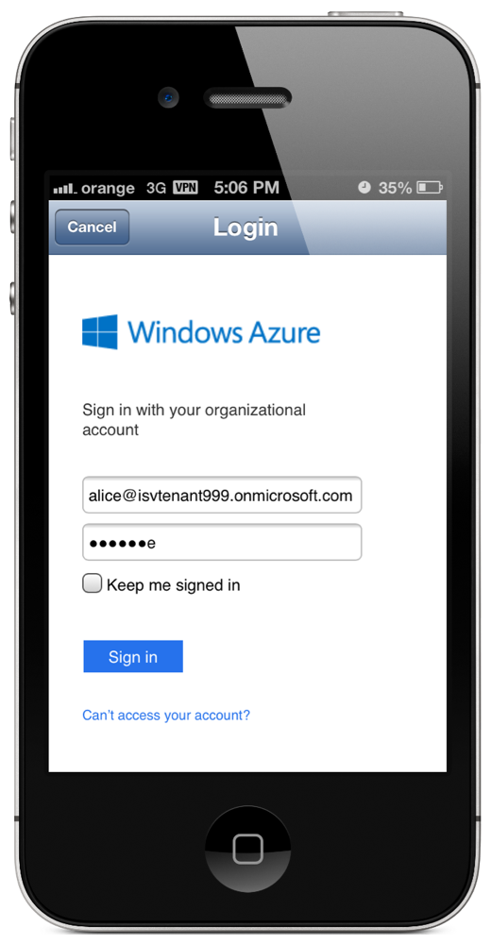
Coming Soon!

Slide 16
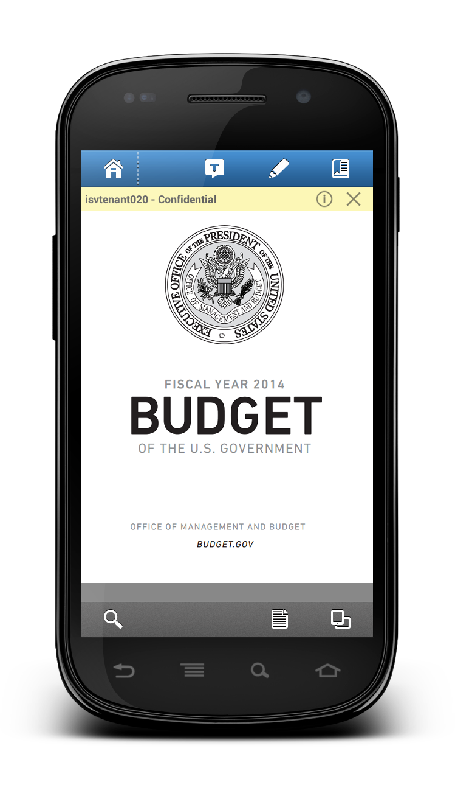
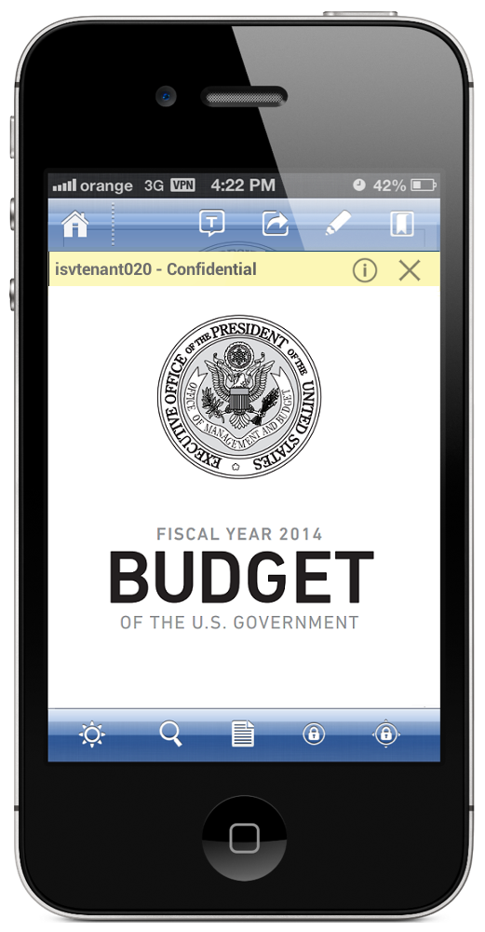
Coming Soon!

Slide 17
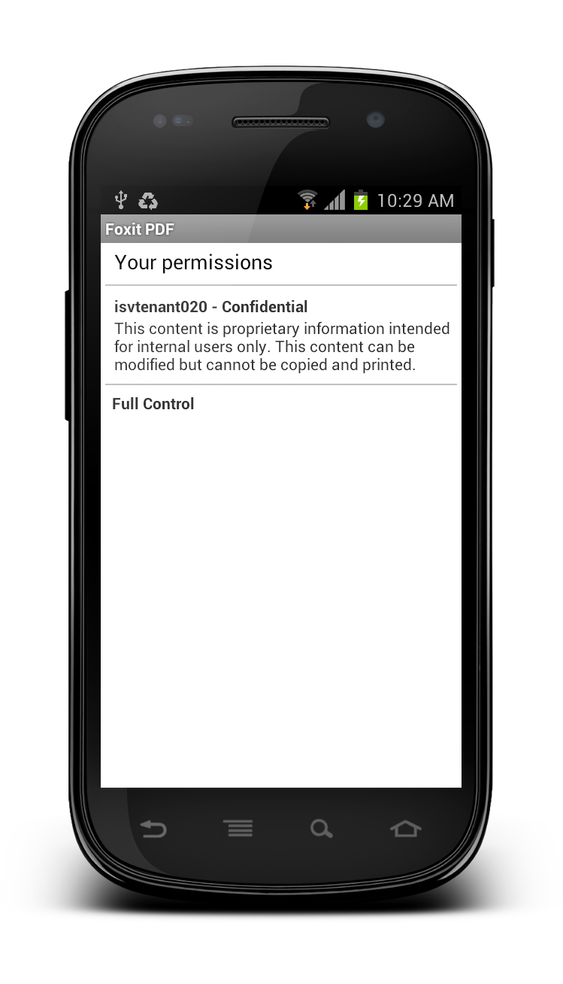
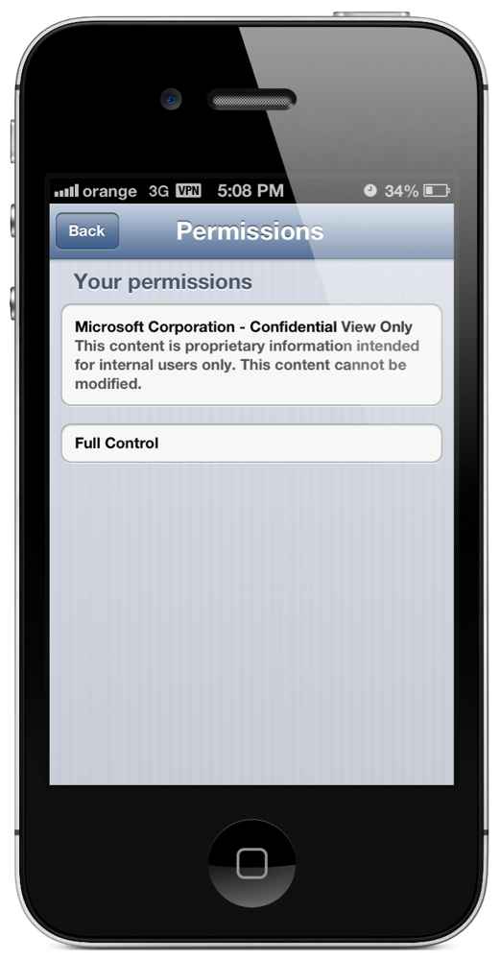
Coming Soon!

Slide 18
Demo:
Protected Text and Images
Pxxx files rendered in IPViewer

Slide 19
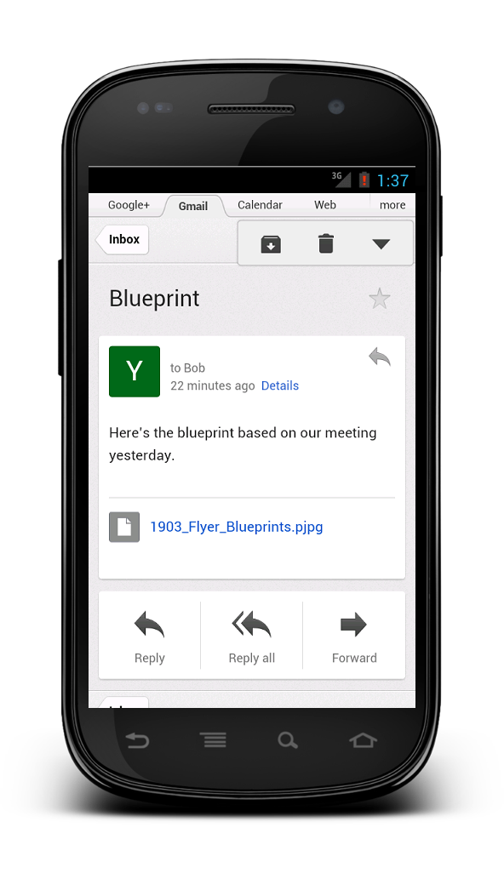
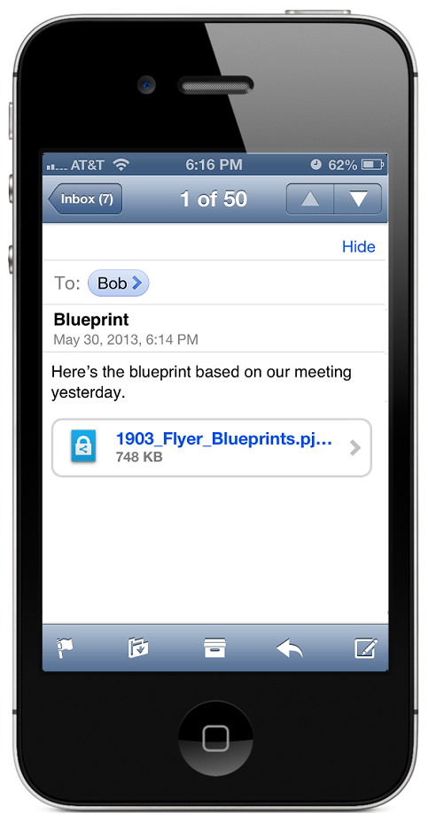
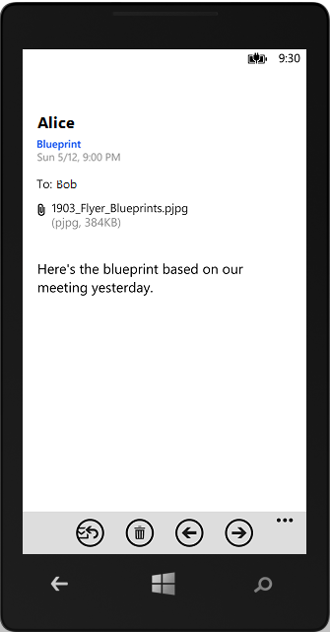

Slide 20
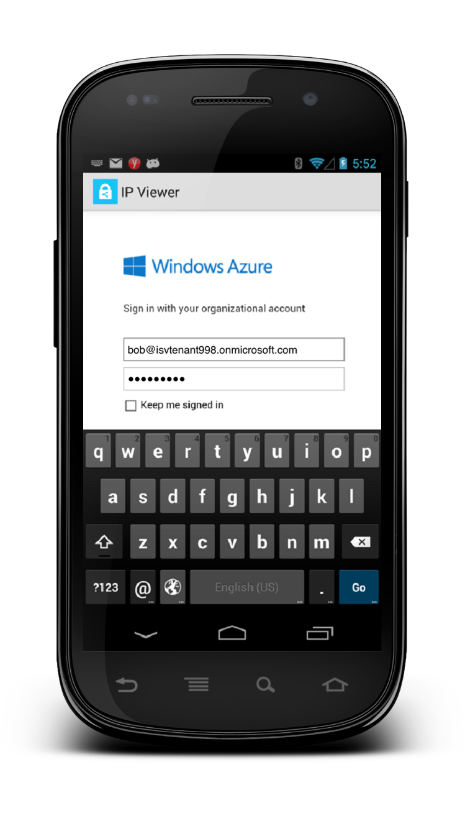

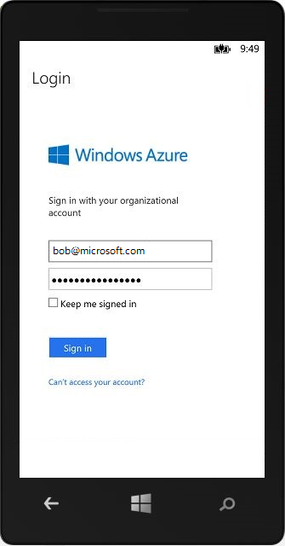

Slide 21
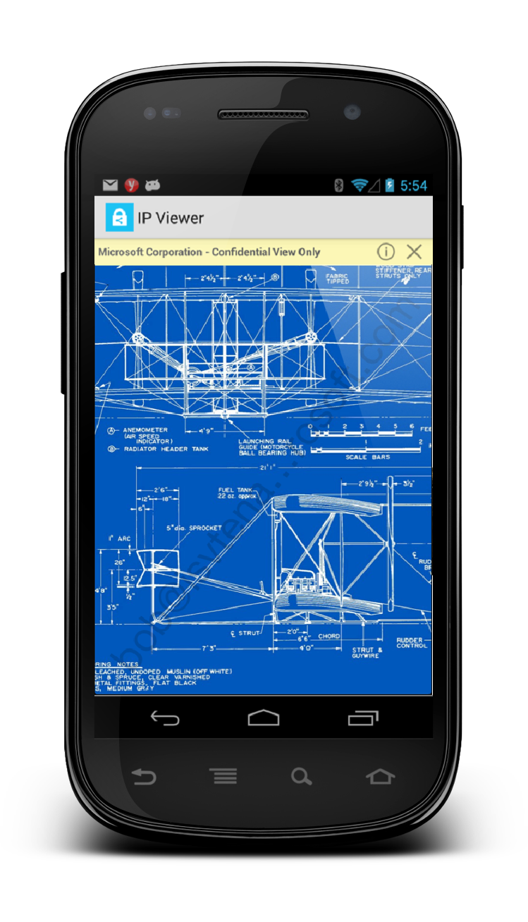
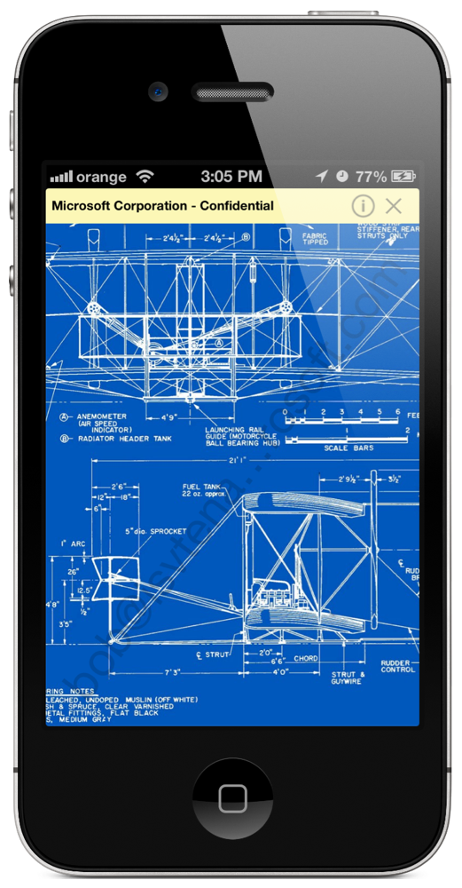
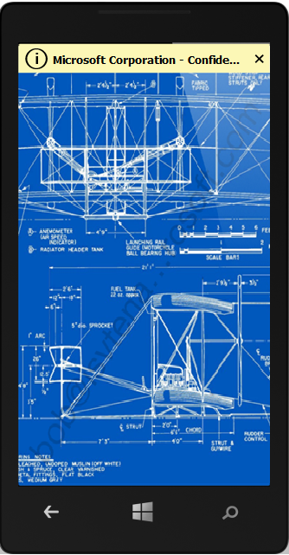

Slide 22
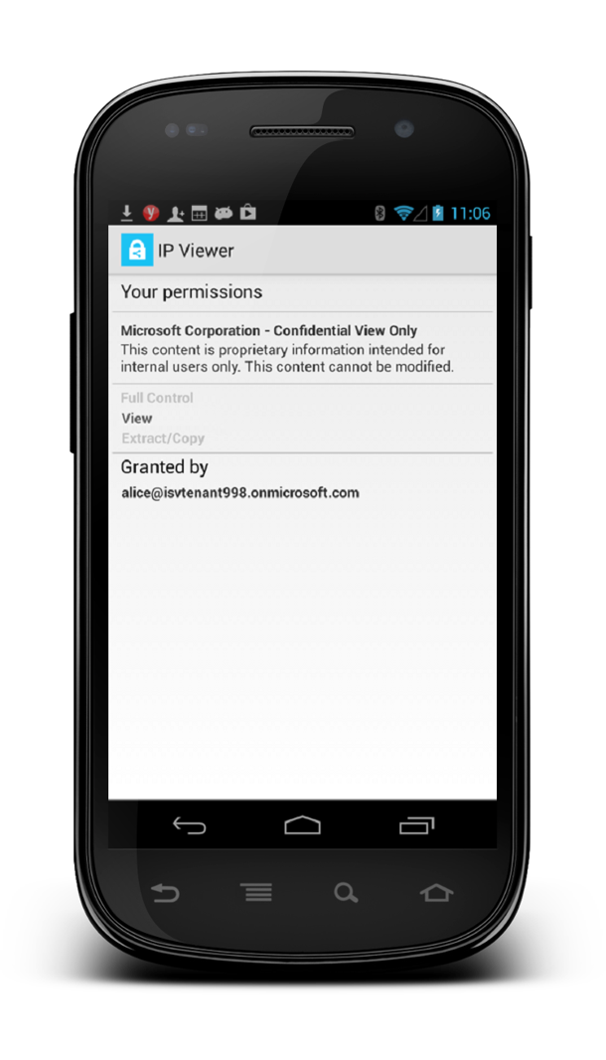
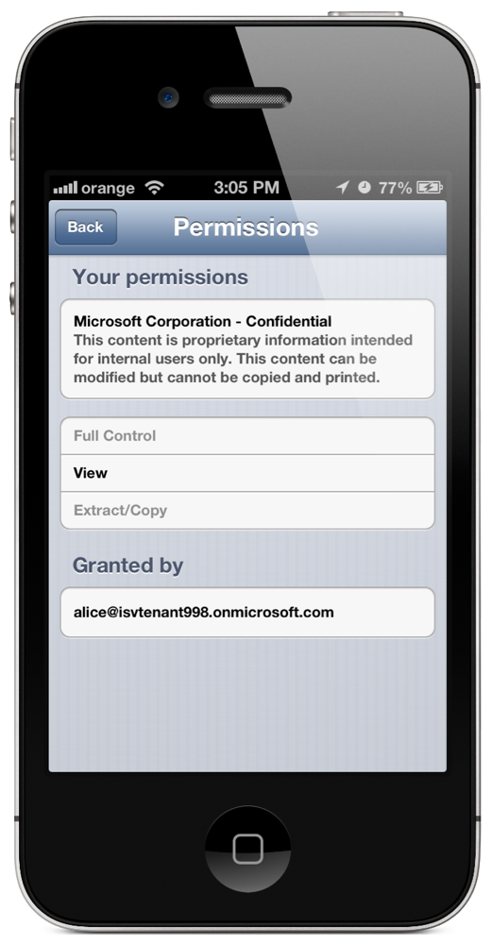
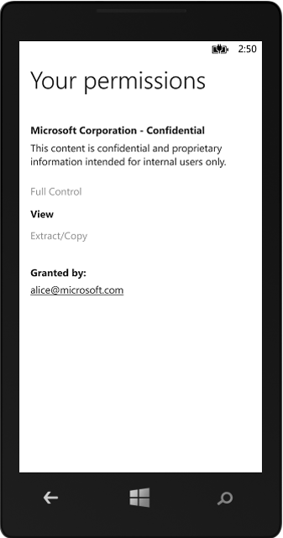

Slide 23

Demo:
User Classification
Today’s demo in partnership with:
TITUS is a leading provider of security and data governance software that helps organizations share information securely while meeting policy and compliance requirements. The enable over 2 million users, in over 500 organizations worldwide.

Slide 24
Classification
Making policy decisions is hard; classification is easier
  e.g.: “Which template should I use for healthcare patient contact information?”
  Classification is a great approach. Ask the user and/or automate classification (more later)
Data protection with integral classification
  RMS specializes in delivering data-type agnostic protection…. We don’t know when to protect.
  Partners, such as Titus, specialize in creating taxonomies that map out business/governance needs
  Placing classification user interfaces into apps (in the right places; all of them) is hard
Our new SDKs integrate classification services
  Developers using the new RMS SDKs don’t do their own UX; we do it for them.
  IT offered templates, user create adhoc policy, and classification can seamlessly coexist!

Slide 25
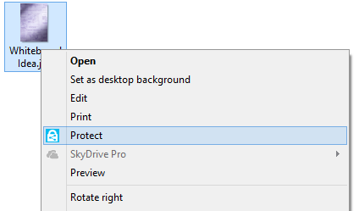
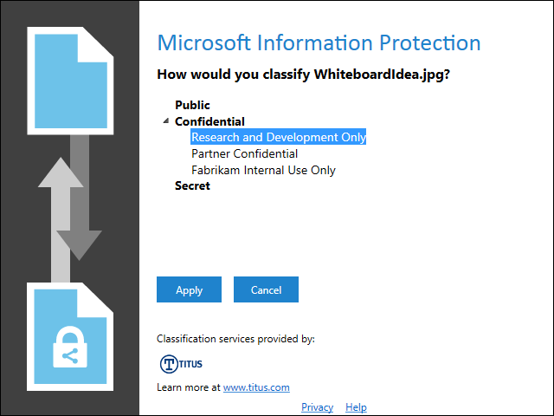
Classification

Slide 26
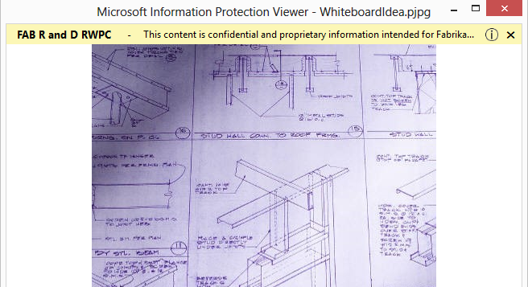
Classification

Slide 27
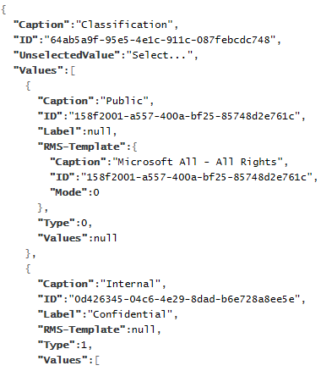
Classification JSON Web Service Feed
RMS Server
Classification
Server
RMS
Enlightened App
(e.g.: IP Viewer)

Slide 28
Automated Classification
WS Work Folders & DAC
WCA-B214
Windows Server Work Folders overview – my corporate data on all my devices
WCA-B332
Windows Server Work Folders – a deep dive into the data sync solution
WCA-B344
Using Dynamic Access Control and Rights Management for Information Protection

Slide 29
Try it yourself!
ITPros – Download IPViewer Beta
  http://connect.microsoft.com/site1170
  Use it with your existing RMS deployment or setup an Office 365 trial E3 account with Azure RMS
Developers – Sign up for our BETA program
  http://connect.microsoft.com/site1170
  Use it with your existing RMS deployment or setup an Office 365 trial E3 account with Azure RMS
  If interested in Classification efforts, sign up for beta program and leave us a private forum post.
Foxit PDF reader
  http://www.foxitsoftware.com/products/rms/TechEd

Slide 30
Internal Sharing of Sensitive Data
Organization of all sizes have sensitive data
  The numbers vary from ~3% to “far more” when customer data contain PII
Data is increasing rarely in a state of permanent rest
  Mobile devices; data sync’d for use at home; SQL/SAP reporting to Excel; etc.
RMS is used / reasoned over by users / software
RMS protects sensitive data at rest and in motion
  RMS, and enlightened applications, offer native supports for file protection
  Outlook and Exchange adds RMS support for email
  Vertical offers are now adding RMS too. SharePoint, DAC, DLP, and now SAP…

Slide 31
SDKs for Enlightened App and Services
Core API
  A powerful, multifaceted API enabling more advanced application uses. E.g.: Office uses this API.
  Average applications require about 400 lines of RMS specific code.
File API
  Simplest API to use – focus in on protection (and un-protection) in the most suitable native format
  Average applications need 2 lines of RMS specific code. Yes, two.
  GetTemplates()
  Protect (File, Template)
  UnProtect (File)
RESTful Web Services
  Used by developers on other platforms, web sites, and multi-function devices (copiers / scanners)

Slide 32

Demo:
Hardened Desktops
Today’s demo in partnership with:
Secure Islands develops and markets advanced and innovative IPC solutions. Its flagship product, IQProtector, automatically applies RMS protection on any file from any source. It enables secure usage of protected files even within un-supported RMS applications. Fortune 500 organizations, are already leveraging AD RMS and Secure Islands to deliver a holistic information protection solution for DLP, client data confidentiality, compliance, cloud and cyber security.

Slide 33
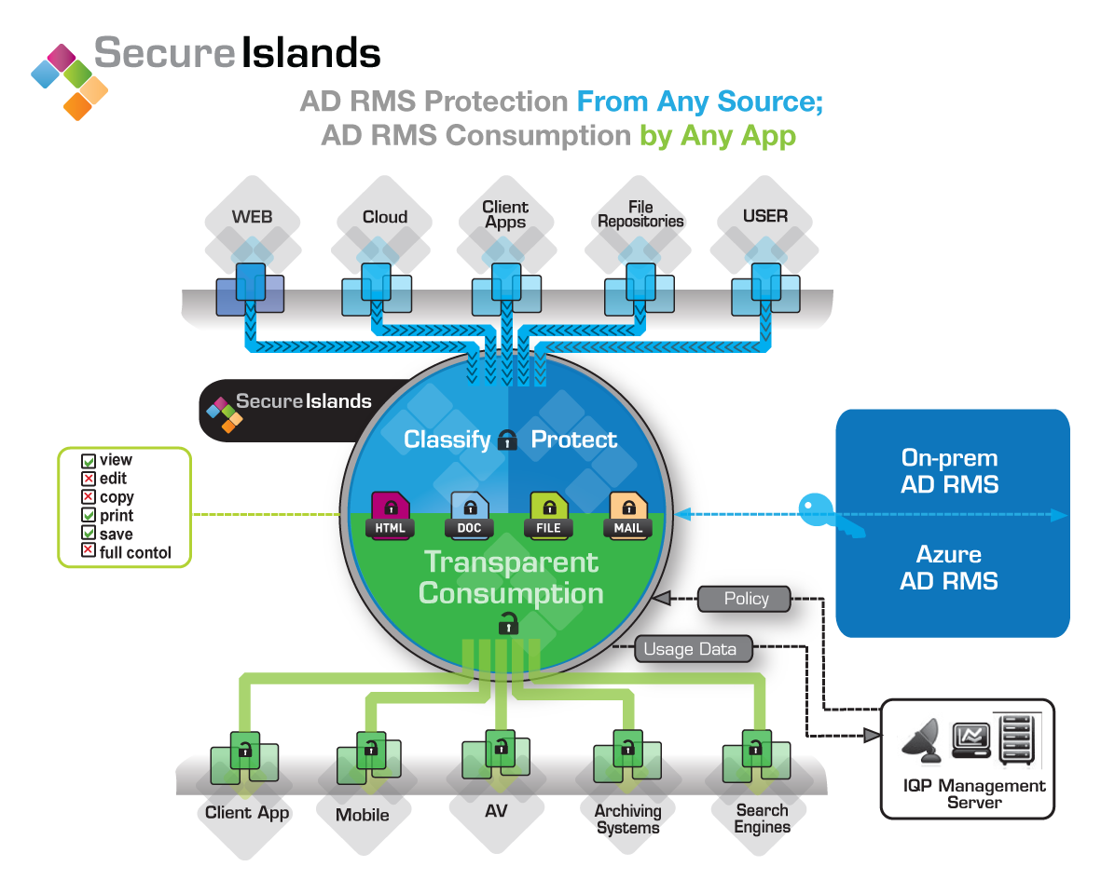

Slide 34

Demo:
Protected SAP Reporting
Today’s demo in partnership with:
SECUDE is an innovative global provider of information protection solutions. The company was founded in 1996 as a partnership between SAP AG and the Fraunhofer Institute in Germany. With offices in North America, Europe and Asia, SECUDE is globally renowned for providing multilayered data protection both on-premise and in the cloud for a large number of Fortune 500 companies.

Slide 35





Secude offering SAP data protection
SAP NetWeaver
Secude Service
Window Server
AD RMS
Window Azure
AD RMS
Classify
then
Protect
Encrypt With
AD RMS
SDK
Download / Export
Data never seen
by RMS server
Front-End
Cloud
Drive

Slide 36
Sharing with Anyone: B2B and B2I
Collaboration is about validating B2B/B2I identities
  Secure file collaboration must be as easy as normal document sharing
  ITPros do not want to enable direct party-to-party trust
Azure AD + AADRM acts as neutral, trusted broker
  When paired (once), RMS enables seamless secure collaboration
  Azure AD will become a commonplace extension of the corporate AD offer
  http://channel9.msdn.com/posts/Windows-Azure-Active-Directory-Cartoon
Collaboration is often about sharing with others
  An ‘RMS for Individuals’ offer will soon exist that lets anyone sign up, for free.
  Initially biased for organizations, but adding Microsoft Account and Google ID

Slide 37


Seamless, Secure B2B Collaboration
RMSO
AAD
AAD
Sally
Ellen
AD
AD

Slide 38
Sharing with anyone – User Experience
Invoke
‘Share Protected’
Pick People
(email addrs)
Set
desired
Permissions
Send
Invite
(email)
Receive email
Sign in
or
Sign up
Open document

Slide 39
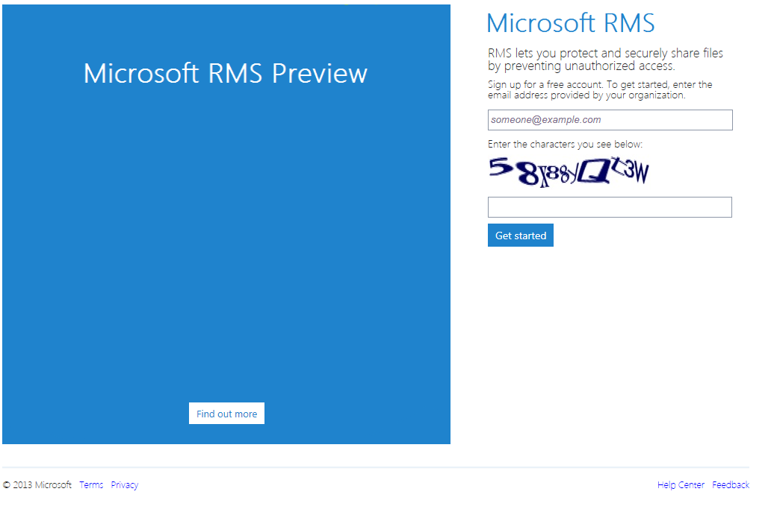

Slide 40
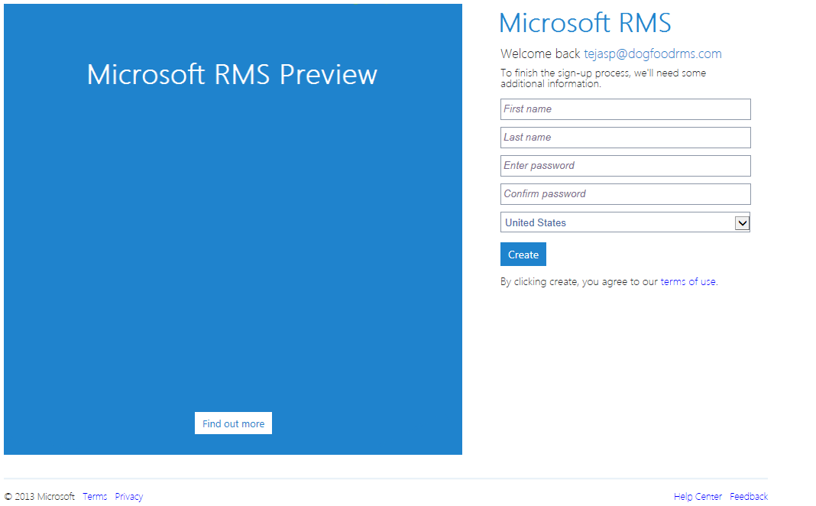

Slide 41
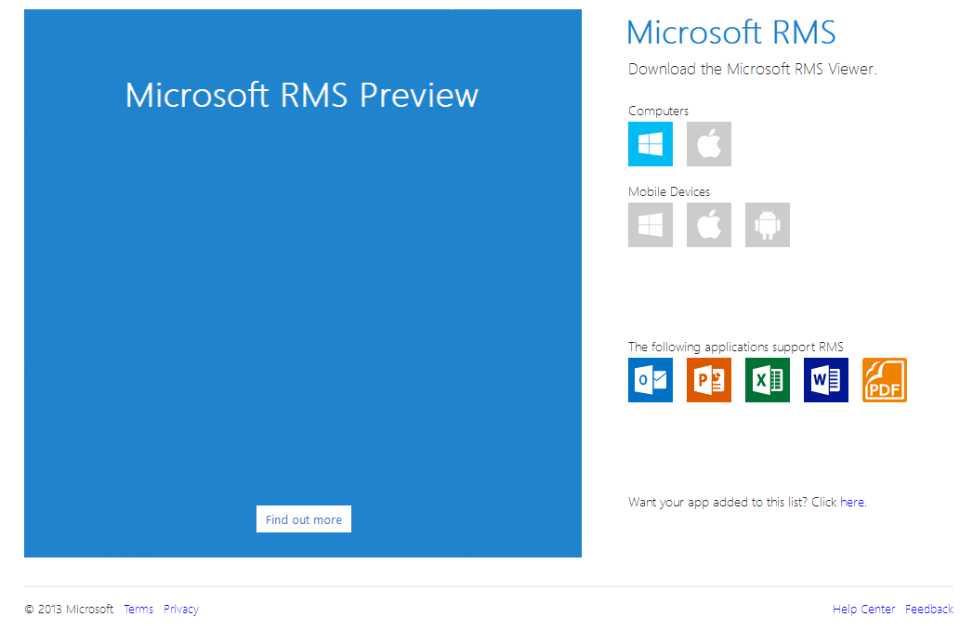

Slide 42
Implementing RMS
Orgs are either Cloud Ready, Accepting, or Hesitant
… and we’ve got solutions for all three
  We’re asking (for good reasons) that even the cloud hesitant ‘put a toe in the cloud’.
Simple purchase options
  Azure RMS Standalone or Office365 SKU AADRMS Add-on (included in E3/E4 tiers)
  Azure RMS will include on-premise AD RMS
  Price is $2/user/month (in quantities of 1) for content owner.
  Consumption/non-owner use is free
  Volume licensing / Enterprise Agreement details being worked out.
WCA-B321 later today covers ALL the details
  This is a must-see walkthrough of all options. It’s followed by a ‘Meet the Experts’ session too.

Slide 43
Modern RMS and your Organization
EMail
Portals
Storage
Protection
Exchange
Online
SharePoint
Online
Cloud
Drives
Azure
AD RMS
Cloud Ready
Exchange
SharePoint
Cloud Accepting
Windows FCI
AD RMS
Cloud Hesitant

Slide 44
RMS Topologies – Timeline of offers
CY13H1 H2
Cloud Ready
Office365 with Azure AD RM
All-in-one offer (Simplest)
Azure ADRM
Mix of Connector with O365 Services
Cloud Accepting
Azure RMS
Connector (Basic)
Azure AD RM
Service Co-existience
Cloud Hesitant
AD RMS
Azure AD RM
Connector (Advanced)
(BYOK + Realtime Logging)

Slide 45
Key control is often very… key
Thales HSMs host your keys in locked cages
  We can’t see your key so we can’t leak them – All BYOK keys are in the HSM with ‘no export’
Near-realtime logs offer views of key usage
  Given we can use your keys, we could abuse them. We give you near-realtime logs. Watch us.
Initial key ceremony is air-gapped and with quorum
  Your key is cached by our HSMs so we need to securely trans-crypt them to our HSM’s security world.
  You fly to Redmond**, trans-crypt the key, and leave with it (we keep nothing).
Fail-safe cache clearing via ‘Key Rejuvenation’
  Cached keys have a 4 hours TTL. You push every 2hrs. No push = keys die = content is ‘bricked’.

Slide 46

What is an HSM?
An HSM is a specialized hardware device that stores and manages cryptographic keys for services and applications.
It performs cryptographic operations such as encryption and digital signatures.
All functions occur within the logical and physical confines of a tamper resistant HSM.
The components are embedded within a tamper resistant epoxy resin and keys are never exposed in the memory of any host server or anywhere outside the certified boundary of the HSM.
Thales’s major references
19 of the 20 largest banks
Over 3,000 financial institutions
70% of the world’s banking transactions
3 of the largest pharmaceutical co.
4 of the 5 largest petrochemical co.
9 of the 10 largest high tech industries
25 NATO member countries are equipped with Thales’ solutions

Slide 47

Minimal footprint: Collaboration + Reach
RMSO
KMS
(HSM)
AAD
RMS
Apps
Office Apps
Device
EAS
PC
RMS
Apps
AD
Ex
SP
HSM

Slide 48
Decisions, Decisions, Decisions
Azure AD RM for O365 is easiest way to get IP
  Info protection is most approachable if you can adopt Office 365
AADRM Hybrid Connector is quickest way to get IP
  Office 2013 + the hybrid connector get you going very quickly.
For the most paranoid, use the BYOK key offers
  Bring your own key + logging + log analysis (from partners) + key rejuvenation
Generic Protection offer creates maximum reach
  If your favorite RMS-enlightened app is not yet on yet on your platform, then use *.PFILE protection. It assumes a bit more trust (and there is a greater risk of data leakage) but works everywhere and is far, far better than what you do now(!).
  IPViewer and new SDKS available on 6 platforms

Slide 49
This can be a bit overwhelming…
It’s really simpler than it sounds but should you desire help, there are many folks in the know:
Your Microsoft Sales Partner
  You know where to find them + they know where to find you. We support them directly.
Microsoft Consulting Services (MCS)
  Your sales partner can help make the connection. We support them directly.
Synergy Advisors
  Cristian and his team specialize in RMS deployments these days.
  Several of their folks are staffing our booth so please drop by.
When all else fails, AskIPTeam@microsoft.com

Slide 50

Windows Track Resources
Windows Enterprise: windows.com/enterprise
Windows Springboard: windows.com/ITpro
Microsoft Desktop Optimization Package (MDOP): microsoft.com/mdop
Desktop Virtualization (DV): microsoft.com/dv
Windows To Go: microsoft.com/windows/wtg
Outlook.com: tryoutlook.com

Slide 51

Resources
Learning
channel9.msdn.com/Series/Information-Protection
  Sessions on Demand
  Microsoft Certification & Training Resources
http://channel9.msdn.com/Events/TechEd
www.microsoft.com/learning
TechNet
msdn
  Resources for IT Professionals
  Resources for Developers
http://microsoft.com/technet
http://microsoft.com/msdn

Slide 52







Complete an evaluation on CommNet and enter to win!

Slide 53



Evaluate this session
Required Slide
*delete this box when your slide is finalized
Your MS Tag will be inserted here during the final scrub.
Scan this QR code to evaluate this session and be automatically entered in a drawing to
win a prize

Slide 54

© 2013 Microsoft Corporation. All rights reserved. Microsoft, Windows and other product names are or may be registered trademarks and/or trademarks in the U.S. and/or other countries.
The information herein is for informational purposes only and represents the current view of Microsoft Corporation as of the date of this presentation. Because Microsoft must respond to changing market conditions, it should not be interpreted to be a commitment on the part of Microsoft, and Microsoft cannot guarantee the accuracy of any information provided after the date of this presentation. MICROSOFT MAKES NO WARRANTIES, EXPRESS, IMPLIED OR STATUTORY, AS TO THE INFORMATION IN THIS PRESENTATION.

